Slide 1
Smart meters/metering
Pavel Klenovsky, WELMEC Chair
Presentation for OIML RT of RLMO – discussion paper
September, 2021

Slide 2

Smart meters (SM)
applicable to all the traditional utility meters:
electricity meters
gasmeters
thermal energy meters
watermeters
electronic communication as such used in operation of other legally controlled measuring instruments
this presentation is concentrated on electricity meters, now being under spotlight
their important feature: a high amount of data to be transferred

Slide 3
Definition (related to electricity meters)
smart metering system:
an electronic system that is capable of measuring electricity fed into the grid or electricity consumed from the grid, providing more information than a conventional meter, and that is capable of transmitting and receiving data for information, monitoring and control purposes, using a form of electronic communication;
Source: so called Electricity directive 2019/944/EU, art. 2 Definitions, definition no. 23

Slide 4
Legislation (electricity meters)
originally concentrated on active energy as tariffs for citizens were simple and based only on active energy consumption
now it is fast becoming no more the case
it is the case of MID, MI-003 in Europe and OIML R 46 in the world - they now appear horribly obsolete
OIML TC 12 works on a revision which is progressing slowly
the matter is complicated by the fact that there is albeit a plentiful of IEC standards where, however, typical metrological requirements are not covered (to collate all those sources is a horrible task)

Slide 5
Typical hardware design
a 4-quadrant meter being able to measure active/reactive energy in both directions (consumption/delivery of energy)
a separate registration of the consumed and delivered energy in each phase (Ferraris meters cannot do that)
in polyphase meters various phases can be dedicated either to consumption or delivery (e.g. 2 phases used for consumption, 1 phase used for delivery) – to test it is not trivial
multi-tariff capability
the handling of the measurement results according to national legislation (the delivery from a PVE to be subcontracted from the consumption ?)
often internal computational capability (e.g. by way of PLC – Programmable Logic Controller)

Slide 6
Typical hardware design
normal billing period: 1 month, data storage capability: 40 days
real time access to energy consumption data - 5 minutes up to 60 minutes data interval: free interval electricity smart meters
dynamic price contracts
communications: point-to-point technologies, meters as IoT using mobile internet implementing e.g. novel communication technology called NB-IoT (Narrowband Internet of Things), LPWAN (Low Power WAN) standard using GSM 4G/LTE or GSM 5G/LTE networks in radio bands reserved for industrial frequencies

Slide 7
Software design
In Europe given by the well-known guide WELMEC 7.2 (common sense) – from the viewpoint of SW there are 2 types of meters:
type P: with embedded SW
type U: based on a universal computer, now typical for a smart meter
Both types of devices can have various so called extensions:
extension S: separation of SW into Legally relevant part (LRS) and Legally non-relevant part (LNRS) – mandatory for type U devices
extension D: remote download – not supported by some national legislations even if the options are well known (Verified/Traced update)
extension T: remote transfer of data – a typical attribute of a smart meter, SW on both sides of the communication has to be known)

Slide 8
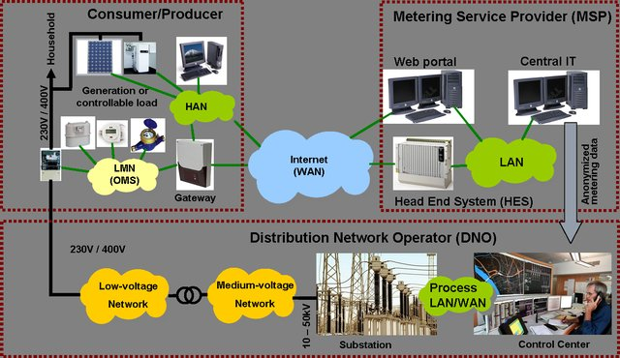
Scheme of a modern energy networks

Slide 9
Complexity of the associated legislation
The interplay of the relevant legislations is quite complex – the following categories of legislation are applicable here:
metrological (EU MID directive, national level)
electricity (grid) regulation (EU Electricity directive)
cyber-security (national cybersecurity regulation based on 2016/1148/EU – NIS directive, the grid is a critical infrastructure)
protection of personal data, privacy of data (EU Regulation GDPR – 71 % of consumers fear of their personal information being stolen while using smart home products).

Slide 10
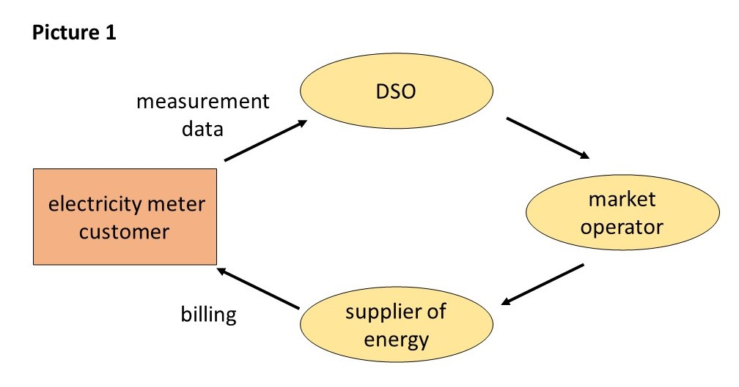
Additional complexity - unbundling
Liberalized energy market (unbundling) – mandatory in Europe:
DSO = Distribution System Operator

Slide 11
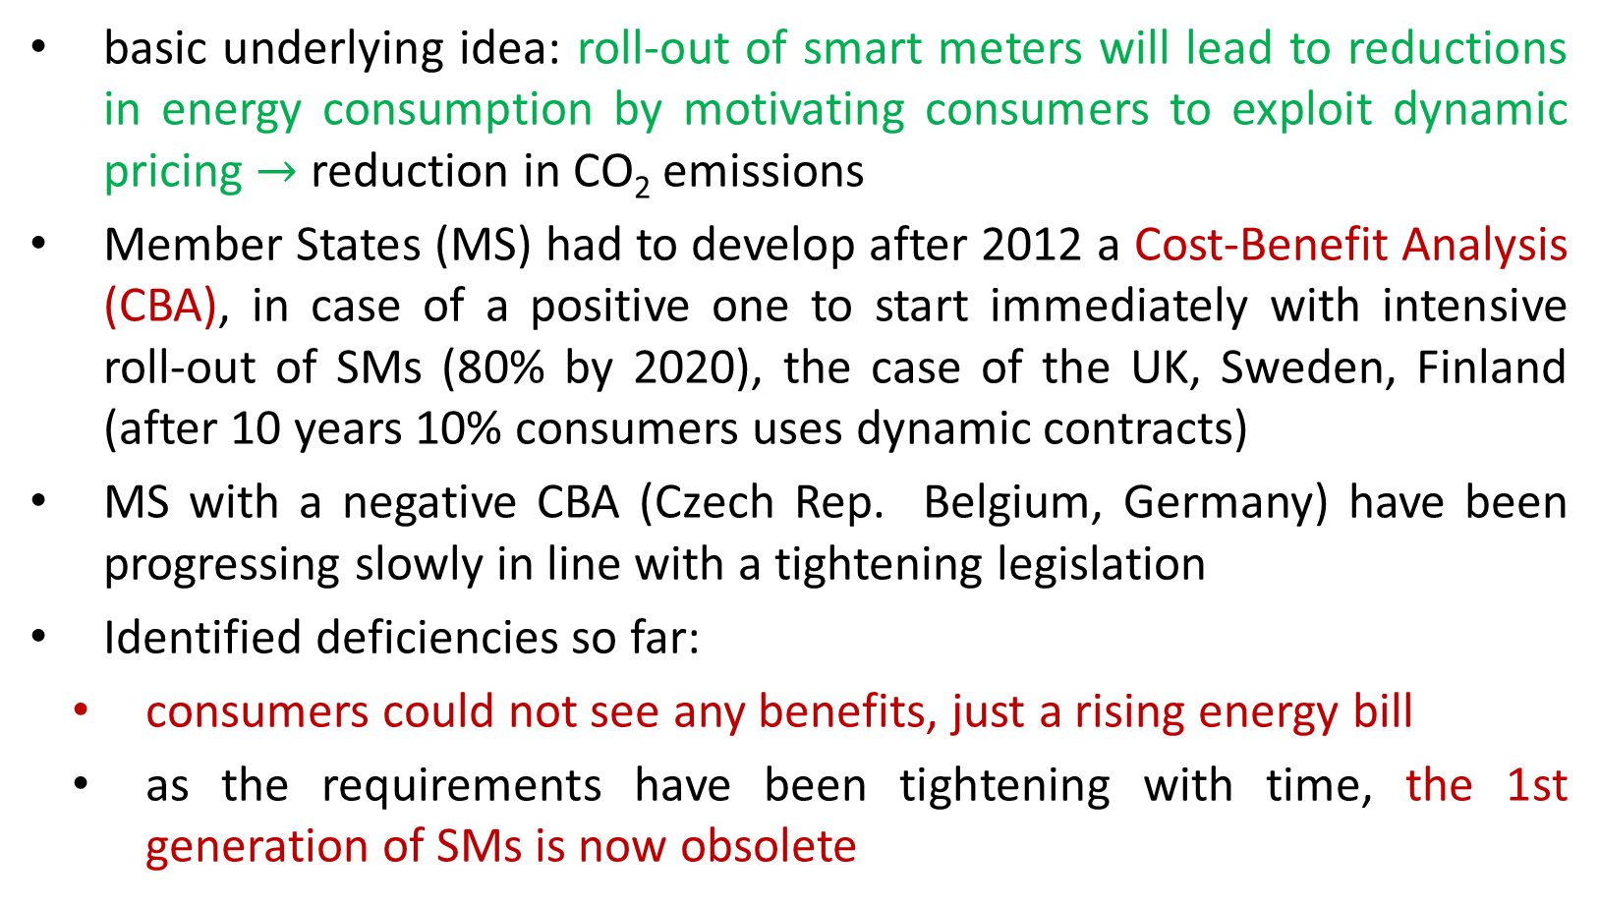
European approach
basic underlying idea: roll-out of smart meters will lead to reductions in energy consumption by motivating consumers to exploit dynamic pricing $→$ reduction in CO₂ emissions
Member States (MS) had to develop after 2012 a Cost-Benefit Analysis (CBA), in case of a positive one to start immediately with intensive roll-out of SMs (80% by 2020), the case of the UK, Sweden, Finland (after 10 years 10% consumers uses dynamic contracts)
MS with a negative CBA (Czech Rep. Belgium, Germany) have been progressing slowly in line with a tightening legislation
Identified deficiencies so far:
consumers could not see any benefits, just a rising energy bill
as the requirements have been tightening with time, the 1st generation of SMs is now obsolete

Slide 12
European approach – lessons taken
a clear indication that any reductions in energy consumption as a result of a roll-out of SMs have been achieved still remains to be seen
it is an ardent task to motivate consumers to actively cooperate on energy savings (to respond to dynamic pricing of energy – with renewable energy sources quite a challenge)
some say that it is a blind alley from the start
in all the MSs energy savings have been achieved by mere general technological progress
in MS with a lower GDP considerable savings have been achieved due to relatively high energy prices
Conclusions:
high expectations as regards energy savings probably not fully materialized
however, some benefits of SMs remain valid

Slide 13
Metrological problems I
WELMEC WG 7 has succeeded to prepare detailed requirements for all the extensions of P- and U-type devices
the only exception is the extension T where the final conclusion is that the communication protocol/SW can only be fully validated (certified) when on both ends there is a LRS software
as in the most practical situations the SW on the side of the data receiver (e.g. on the DSO side) is unknown, not available or simply changed frequently the most important extension for SMs, the extension T, cannot effectively be fully certified, especially in the liberalized market
even the essential requirement of testing whether the communication SW does not negatively influence the SW in the meter itself (its metrological characteristics) is hardly possible to be made – a matter of frustration

Slide 14
Metrological problems II
the „one-dimensional“ communication channel simply defies any comprehensive certification – the solution might consist in a 2 channel architecture of the electricity meter (next slide)
basic underlying idea: the end consumer should have a direct access to „his/her“ data on consumption by way of a (metrologically) regulated communication channel (this data should be a basis for the billing) – in such a case, it would not be necessary to (metrologically) regulate the other communication channel (to the DSO, to a cloud, anywhere)
in fact, the reasons for such an arrangement are threefold:
the requirements of the metrological legislation (protection of consumers)
the requirements of cyber-security legislation (or protection)
the requirements of data privacy

Slide 15
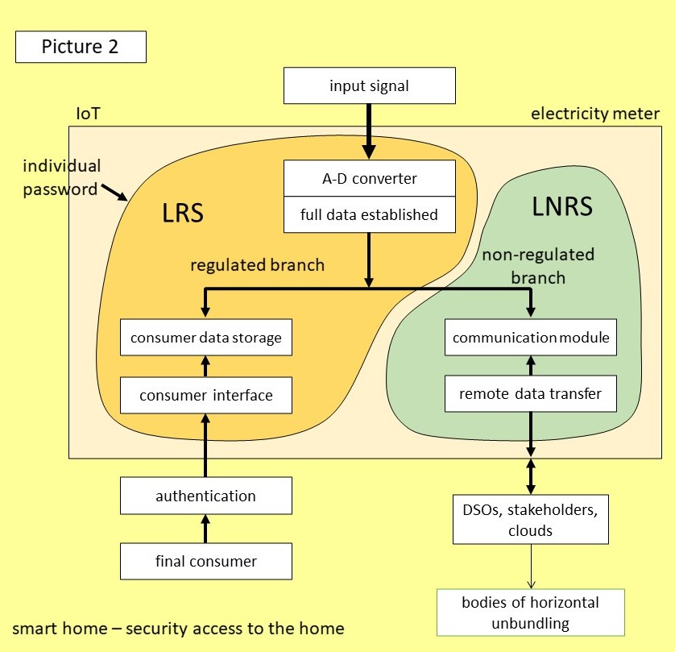
Metrological problems II

Slide 16
Communication protocol DLMS COSEM
the complexity of problems associated with SMs can be exemplified on this popular communication protocol
DLMS (Device Language Message Specification)/COSEM (Companion Specification for Energy Metering)
developed by an association of some leading manufacturers of electricity meters with the aim to have a highly unified, interoperable protocol
it is supported by international standards: a set of standards IEC 62056
DLMS User association offers to manufacturers a certification of any application under this protocol
the MID requirements have not been taken into account at all when developing the SW (a statement to CMI by the User association) !
CMI specialists on SW validation during certifications asked that the SW controlling application of this protocol „sitting“ on computers of the DSO be made available to them

Slide 17
Communication protocol DLMS COSEM
the following has been found:
the total amount of the consumed energy could be arbitrarily deleted without breaking the seal;
the transformer ratio of the meter could be changed within + 1 %;
it was possible to manipulate freely with the readings on the display, the display could even be switched off – in such a way the consumer could be denied any access to the measured data or even to present him/her false ones.
without referring to any legislation, this constitutes a flagrant violation of any consumer protection rules (primarily, by the SM manufacturer when creating/programming the corresponding DLMS application)
it is an example of what can happen when a full attention is given to concentrate only on communication features of the SW in a situation when any SW testing from some other legitimate points of view cannot be made
the situation a little bit reminds the „memory replacement attack“ described by NIST in July issue of the OIML Bulletin

Slide 18
Response in metrological regulations
the consumer protection has always been based on the capability of the consumer to check, independently on the supplier, the amount of the goods delivered (e.g. energy)
until now, a display on the meter has served the purpose
it could not be used when the amount of the corresponding information is huge and cannot therefore be delivered to consumer via a display
the solution - any law on metrology should contain the following provision:
The user of the measurement data shall make sure that the consumer is able to check the measurement data used for billing and if necessary to make available to the consumer suitable tools for this purpose.

Slide 19

Thank you for your attention !
www.welmec.org

