Slide 1
RLMO Round Table Meeting OIML-CS Update
30 September 2021
Mannie Panesar Management Committee Chairperson | Paul Dixon BIML Assistant Director OIML-CS Executive Secretary

Slide 2
Participation in the OIML-CS
AFRIMETS
APLMF
COOMET
GULFMET
SIM
WELMEC
ISSUING AUTHORITIES
UTILIZERS
ASSOCIATES

Slide 3
AFRIMETS
SADCMET: Angola, Botswana, Dem. Rep. Congo, Lesotho, Madagascar, Malawi, Mauritius, Mozambique, Namibia, Seychelles, South Africa, Swaziland, Tanzania, Zambia, Zimbabwe
SOAMET: Benin, Burkina Faso, Côte d'Ivoire, Guinea Bissau, Mali, Niger, Senegal, Togo
CEMACMET: Cameroon, Central African Republic, Chad, Congo Brazzaville, Equatorial Guinea, Gabon
EAMET: Burundi, Kenya, Rwanda, Uganda
MAGMET: Algeria, Mauritania, Morocco, Tunisia
NEWMET: Egypt, Ethiopia, Ghana, Libya, Nigeria, Sudan

Slide 4
APLMF
Australia, ​Brunei Darussalam, Cambodia, Canada, People's Republic of China, Hong Kong China, Indonesia, Japan, Kiribati, Republic of Korea, Malaysia, Mongolia, New Zealand, Papua New Guinea, Peru, Philippines, Singapore, Chinese Taipei, Thailand, United States of America, Vietnam
Chile, Colombia, DPR Korea, Laos D.P.R., Mexico, Russian Federation

Slide 5
COOMET
Armenia, Azerbaijan, Belarus, Bosnia Herzegovina, Bulgaria, People’s Republic of China, Cuba, DPR of Korea, Georgia, Germany, Kazakhstan, Kyrgyzstan, Lithuania, Moldova, Romania, Russia, Slovakia, Tajikistan, Turkey, Ukraine, Uzbekistan

Slide 6
GULFMET
United Arab Emirates, Kingdom Of Bahrain, Kingdom Of Saudi Arabia, Sultanate Of Oman, State of Qatar, State Of Kuwait
Bosnia And Herzegovina, Egypt, Turkey, Republic of Korea, Hong Kong

Slide 7
SIM
Noramet: Canada, Mexico, USA
Carimet: Antigua and Barbuda, Bahamas, Barbados, Dominica, Dominican Republic, Grenada, Guyana, Haiti, Jamaica , St. Lucia, St. Kitts and Nevis, St. Vincent and Grenadines, Trinidad and Tobago
Camet: Belize , Costa Rica, El Salvador, Guatemala, Honduras, Nicaragua, Panama
Andimet: Bolivia, Colombia, Ecuador, Peru
Suramet: Argentina, Brazil, Chile, Paraguay, Uruguay

Slide 8
WELMEC
Albania, Austria, Belgium, Bosnia and Herzegovina, Bulgaria, Croatia, Cyprus, Czech Republic, Denmark, Estonia, Finland, France, Germany, Greece, Hungary, Iceland, Ireland, Italy, Kosovo, Latvia, Lithuania, Luxembourg, Malta, Moldova, Montenegro, Netherlands, North Macedonia, Norway, Poland, Portugal, Romania, Serbia, Slovakia, Slovenia, Spain, Sweden, Switzerland, Turkey

Slide 9
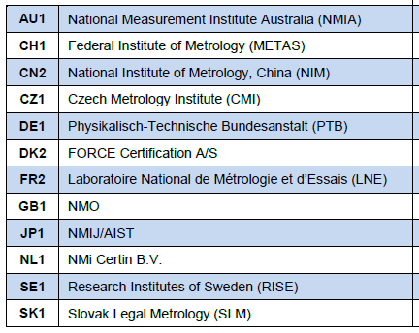
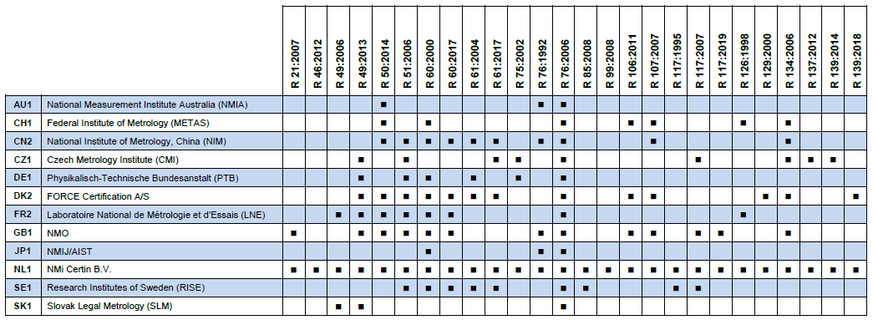
OIML Issuing Authorities
12 out of 62 Member States = 19 %

Slide 10
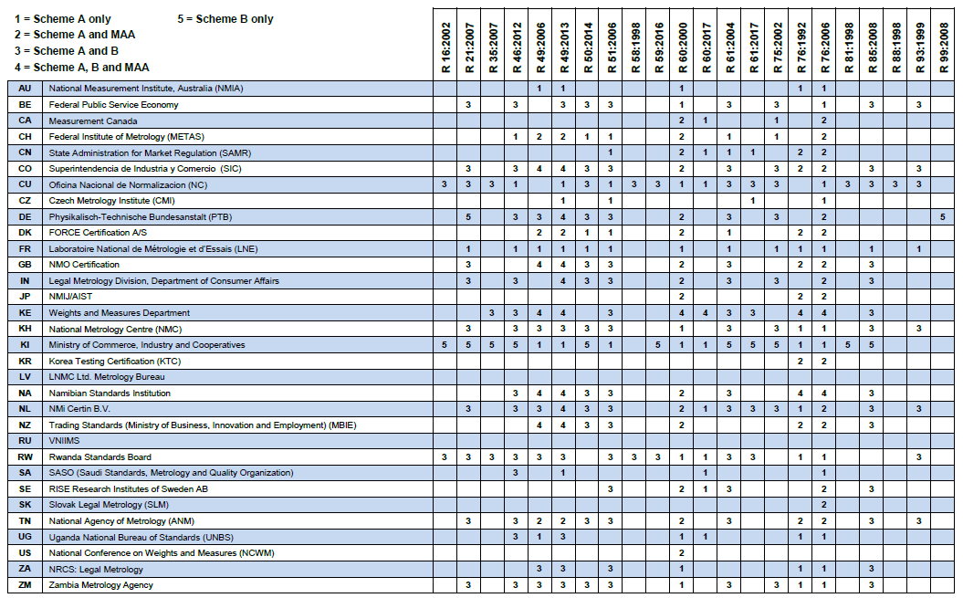
Utilizers and Associates
UTILIZERS: 28 out of 62 Member States = 45%
ASSOCIATES: 5 out of 63 Corresponding Members = 8%

Slide 11
OIML-CS Certificates 1 January 2018 – 30 June 2021

Slide 12
Certificates by Recommendation 1 January 2018 – 30 June 2021

Slide 13
OIML-CS Management Committee (MC)
OIML-CS MC meeting held (online) 24-25 March 2021
Chaired by the new MC Chairperson, Mannie Panesar
Key items:
feedback and experiences of participants - acceptance of certificates, modular approvals, and experience of remote assessments
reports by the Review Committee Chairperson and Maintenance Group Chairperson, including proposals on the activities of the RC and approvals of OIML-CS documents

Slide 14
OIML-CS Management Committee (MC)
Key items (continued):
recommendation from the ISO/IEC 17065 Working Group to allow OIML IAs to use ISO/IEC 17020 (with additional requirements) as an alternative to ISO/IEC 17065 to demonstrate competence
review of OIML IA Annual Reports for 2020 and confirmation of the continued participation of the OIML Issuing Authorities in the OIML-CS
progress report on the update of OIML R 60:2017
high priority publications and periodic reviews

Slide 15
OIML-CS Management Committee (MC)
Next OIML-CS MC meeting to be scheduled for (early) 2022
COOMET, SIM and WELMEC are represented on the MC (as observers)
Nominations from AFRIMETS, APLMF and GULFMET are welcomed

Slide 16
Promotion and Awareness Raising
Representation at RLMO meetings and events – opportunity to promote OIML-CS
New Chair of Working Group - Colombia
Proposals include:
(video) case studies
testimonials from manufacturers
survey (Americas)
Repeat/replicate in other regions?

Slide 17
Items for consideration
Proposals (from RLMOs) to increase participation of RLMO member economies in the OIML-CS as Utilizers or Associates
Identify “users” of certificates who do not participate in the OIML-CS
Identification of barriers to participation

Slide 18
Items for consideration
How is the OIML-CS used to support national/ regional type approval
Participation in RLMO meetings/events
Other updates to RLMOs (e.g. OIML-CS reports are provided to the APLMF for their Newsletter)

Slide 19
Mannie Panesar Management Committee Chairperson | Paul Dixon BIML Assistant Director OIML-CS Executive Secretary
executive.secretary@oiml.org www.oiml.org

