Slide 1

GULFMET
Update to the RLMO Round Table
Omar Kanakrieh
GULFMET Secretary
RLMO Round Table meeting - September 30, 2021

Slide 2
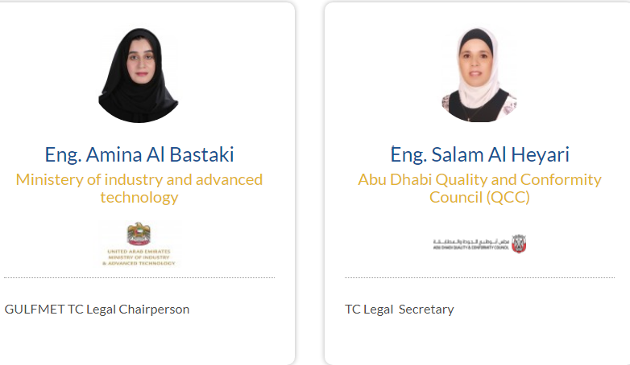
Overview of significant developments and activities during the past year in the RLMO
JCRB MEMBERSHIP:
Decision CIPM/110-13 (2021)
“ Following JCRB Recommendation JCRB/43-1 (2021), the CIPM decided to admit the regional metrology organization Gulf Association for Metrology (GULFMET) as a full member of the JCRB, with a voice and the right to vote”
GULFMET TC legal,
The GSO Ministerial Committee has approved
the GULFMET recommendation to establish
Technical Committee for legal metrology under
the umbrella of GULFMET

Slide 3
Overview of most urgent technical and other legal metrology issues in the region during the past year in the RLMO
Update of the GCC Common Metrology law.
Update the GCC Guidelines on Metrology.
Training needs on:
OIML D1
Smart meters.
Introduce GCC certification Scheme based on OIML CS
Identify the training needs in metrology

Slide 4
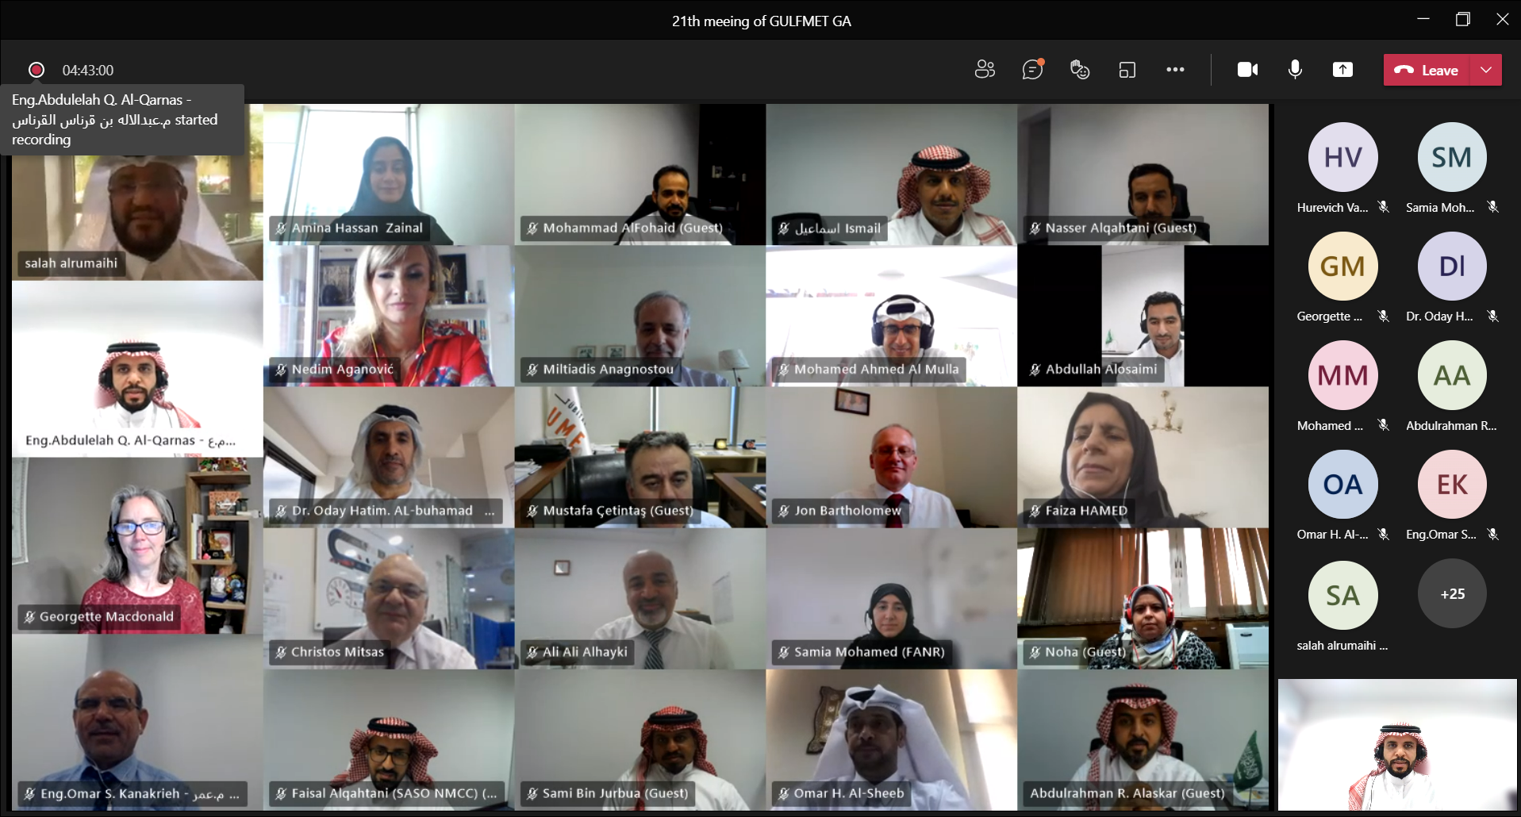
Anticipated calendar of events for the coming year in the RLMO
Last events
- GULFMET Week Events ( June. 6 -10, 2021 )
GULFMET TC legal (June. 6 , 2021)
Upcoming events
- GULFMET Week Events ( Nov. 14 -18, 2021 )
GULFMET TC legal (Nov. 15 , 2021)
- GULFMET Week Events ( June 12 -16, 2022 )
GULFMET TC legal (June. 13 , 2022)

Slide 5
Comments on RLMO discussion topics for this year
Discussion Topic:
How is your RLMO approaching ‘digitalization’ pertaining to measuring instruments in your region?
Existing elements:
Proposal to establish WG on digital transformation– GULFMET will decide on the proposal of establish WG on digital transformation next GULFMET GA in November 2021.
- In response to JCRB 43/1 Action 43/1 All RMOs to communicate to M. Dobre (miruna.dobre@economie.fgov.be) in order to exchange information on digital transformation by the end of March.
GULFMET has nominated Mr. Jon Bartholomew as a representative of GULFMET and a contact person to exchange information on digital transformation.

Slide 6
Summary/Concluding remarks
GULFMET is keen on the following issues:
Harmonization of metrological legislation by getting GCC Common metrology law updated and approved.
Enhance the technical capabilities be identifying the training needs
Introduce GULFMET Capacity Building and Knowledge Transfer Programme.

