Slide 1
Welcome and Update from the
RLMO Round Table
Chairperson
Dr. Charles Ehrlich, CIML 1st VP
RLMO Round Table meeting (Annual) - September 30, 2021

Slide 2
RLMO Round Table Meeting
Thursday, 30 September 2021
10:00–14:00 UTC
Draft Agenda
(v.2, 2021-08-20)
1. Welcome by the RLMO RT Chairperson (Dr. Charles Ehrlich)
2. Roll call
3. Update from the Round Table Chairperson
4. Overview of the main 2021 RLMO discussion topic (Digitalization)
5. Updates from the RLMOs
a. AFRIMETS (Mr. Jaco Marneweck)
  b. APLMF (Dr. Osman Zakaria)
  c. COOMET (Dr. Yuriy Kuzmenko)
  d. GULFMET (Eng. Omar Kanakrieh)
  e. SIM (Mr. Pedro Pérez Vargas)
  f. WELMEC (Dr. Pavel Klenovský)
6. Update from the CEEMS AG Chairperson (Mr. Peter Mason)
7. Update from the OIML-CS Executive Secretary (Mr. Paul Dixon)
8. Special Session: Regulation of ‘Smart Meters’
9. Open Forum on the 2021 RLMO Discussion Topic
10. Future collaborations
11. Conclusions
12. Any other business

Slide 3
Since the 2020 RLMO RT Annual Meeting
The RLMO RT held two Interim Meetings:
14 April 2021
23 June 2021
No update presentations from the RLMOs;
Primarily discussed issues raised at the 2020 Annual RLMO RT Meeting;
Also planned for this 2021 Annual RLMO RT Meeting.
Key Outcomes of the Interim Meetings:
Large amount of strategic planning for RT took place;
RLMO RT site on OIML web site added;
RLMO RT Project Group (PG) Workspaces added;

Slide 4
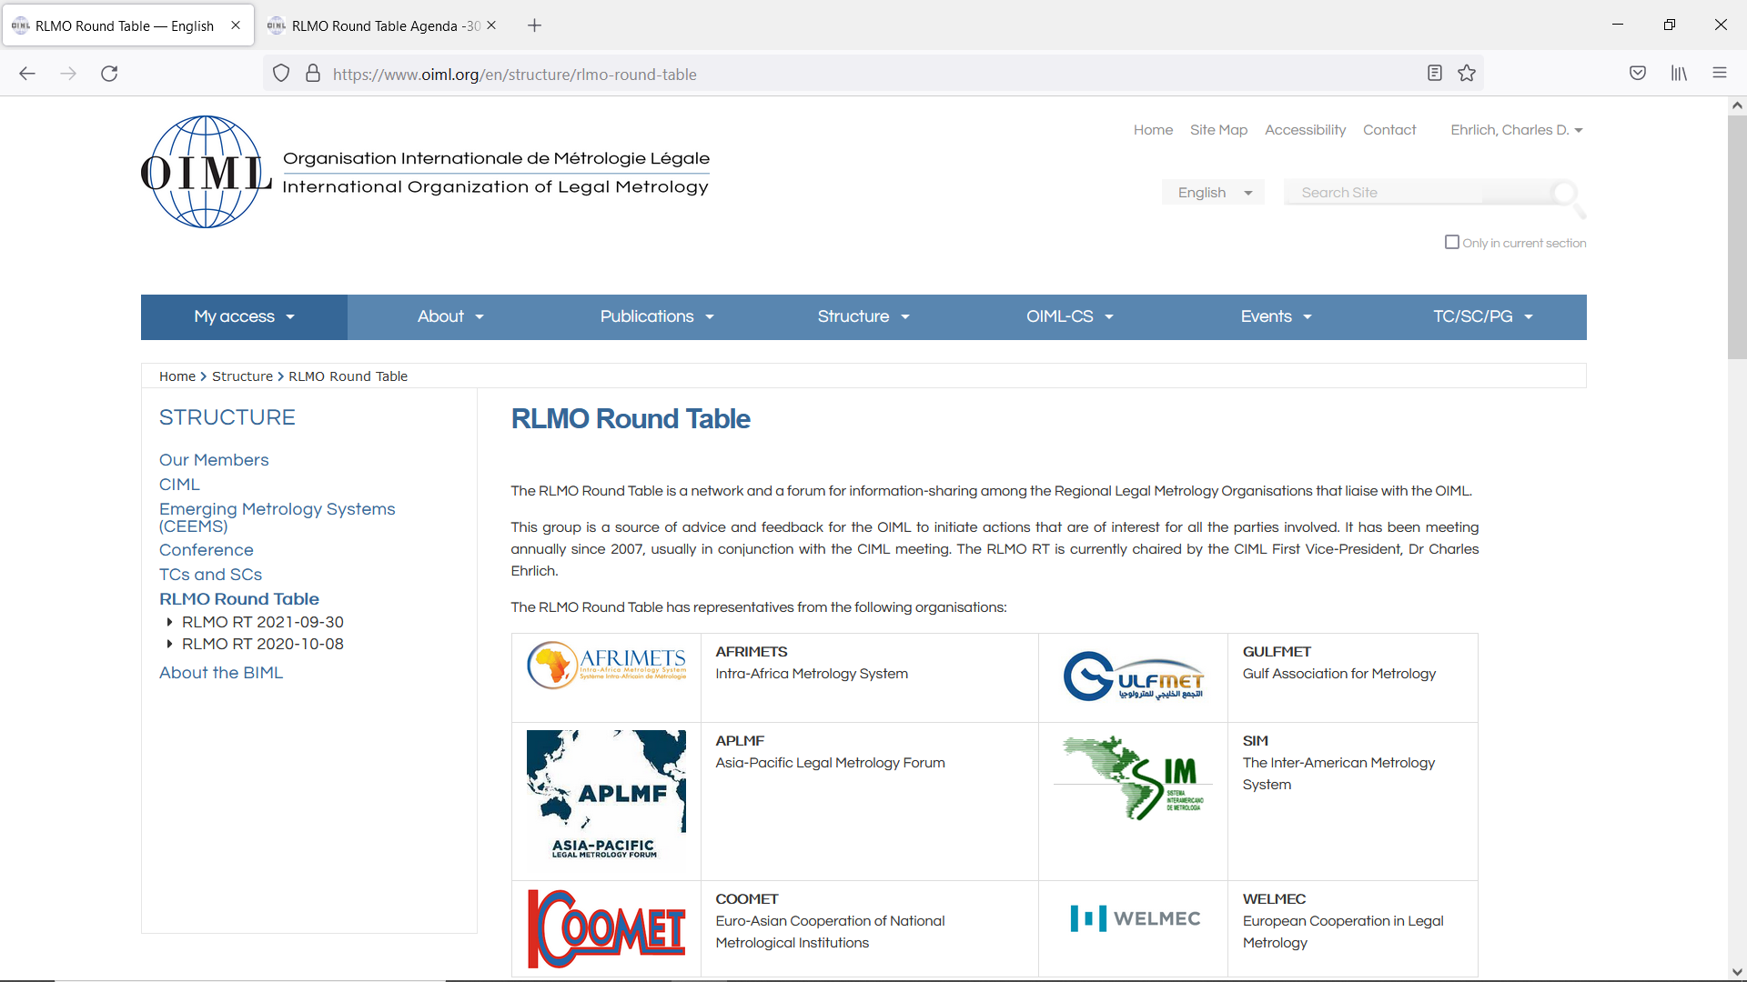

Slide 5
Since the 2020 RLMO RT Annual Meeting
Other Key Outcomes of the Interim Meetings:
Comments on Training and E-Learning from the Interim Meetings will be taken by Ian to the OIML Task Group that is working on this;
Possible Mentors for OIML Bulletin articles/issues identified;
Mannie and Paul offered their continued assistance in providing information about the CS to the RLMOs, and requested more detailed information about what additional information/training/promotion is needed by the RLMOs. Colombia offered assistance with promoting the CS;

Slide 6
Since the 2020 RLMO RT Annual Meeting
Other Key Outcomes of the Interim Meetings:
Volunteers were solicited to work on chapters of an ‘online technologies’ strategy document that is currently under development by the CEEMS AG;
A Project Proposal for the revision of B 12:2004 was discussed, in accordance with what the RT members have actually already agreed on, to be presented to the CIML in October 2021.

Slide 7
Since the 2020 RLMO RT Annual Meeting
Possible topics for next RLMO RT Interim Meeting:
Continue the Annual RLMO RT Meeting as a virtual meeting, to provide opportunity for people to attend who wouldn’t be coming to in-person CIML meetings? Make it a two-day event?;
Open participation to the Annual RLMO RT Meeting to anyone who wants to attend (to promote broader awareness of what is happening in the Regions)?;
Keep the Interim RLMO RT Meetings closed (using them primarily as planning and ‘special-issue’ meetings)?

Slide 8
4. Overview of the main 2021 RLMO Discussion Topic
Discussion Topic:
How is your RLMO approaching ‘digitalization’ pertaining to measuring instruments in your region?

Slide 9
5. Updates from the RLMOs
a. AFRIMETS (Mr. Jaco Marneweck)
  b. APLMF (Dr. Osman Zakaria)
  c. COOMET (Dr. Yuriy Kuzmenko)
  d. GULFMET (Eng. Omar Kanakrieh)
  e. SIM (Mr. Pedro Pérez Vargas)
  f. WELMEC (Dr. Pavel Klenovský)

Slide 10
2021 RLMO Round Table Meeting
6. Update from the CEEMS AG Chairperson (Mr. Peter Mason)
7. Update from the OIML-CS Executive Secretary (Mr. Paul Dixon)
8. Special Session: Regulation of ‘Smart Meters’
9. Open Forum on the 2021 RLMO discussion topic
10. Future collaborations
11. Conclusions
12. Any other business

Slide 11
2021 RLMO Round Table Meeting
6. Update from the CEEMS AG Chairperson (Mr. Peter Mason)
7. Update from the OIML-CS Executive Secretary (Mr. Paul Dixon)
8. Special Session: Regulation of ‘Smart Meters’
9. Open Forum on the 2021 RLMO discussion topic
10. Future collaborations
11. Conclusions
12. Any other business

Slide 12
2021 RLMO Round Table Meeting
6. Update from the CEEMS AG Chairperson (Mr. Peter Mason)
7. Update from the OIML-CS Executive Secretary (Mr. Paul Dixon)
8. Special Session: Regulation of ‘Smart Meters’
9. Open Forum on the 2021 RLMO discussion topic
10. Future collaborations
11. Conclusions
12. Any other business

Slide 13
2021 RLMO Round Table Meeting
6. Update from the CEEMS AG Chairperson (Mr. Peter Mason)
7. Update from the OIML-CS Executive Secretary (Mr. Paul Dixon)
8. Special Session: Regulation of ‘Smart Meters’
9. Open Forum on the 2021 RLMO discussion topic
10. Future collaborations
11. Conclusions
12. Any other business

Slide 14
2021 RLMO Round Table Meeting
6. Update from the CEEMS AG Chairperson (Mr. Peter Mason)
7. Update from the OIML-CS Executive Secretary (Mr. Paul Dixon)
8. Special Session: Regulation of ‘Smart Meters’
9. Open Forum on the 2021 RLMO discussion topic
10. Future collaborations
11. Conclusions
12. Any other business

Slide 15
2021 RLMO Round Table Meeting
6. Update from the CEEMS AG Chairperson (Mr. Peter Mason)
7. Update from the OIML-CS Executive Secretary (Mr. Paul Dixon)
8. Special Session: Regulation of ‘Smart Meters’
9. Open Forum on the 2021 RLMO discussion topic
10. Future collaborations
11. Conclusions
12. Any other business

Slide 16
2021 RLMO Round Table Meeting
6. Update from the CEEMS AG Chairperson (Mr. Peter Mason)
7. Update from the OIML-CS Executive Secretary (Mr. Paul Dixon)
8. Special Session: Regulation of ‘Smart Meters’
9. Open Forum on the 2021 RLMO discussion topic
10. Future collaborations
11. Conclusions
12. Any other business

Slide 17
2021 RLMO Round Table Meeting
Thank you for your participation!

