Slide 1


AFRIMETS
Update to the RLMO Round Table
Mr. Jaco Marneweck Vice-Chairperson Legal Metrology
RLMO Round Table meeting - September 30, 2021

Slide 2













Overview of significant developments and activities during the past year in the RLMO
Agreement Establishing the African Continental Free Trade Area
  Came into force on 30 May 2019
14th AFRIMETS General Assembly
  26 to 28 July 2021
  Virtual

Slide 3

Overview of most urgent technical and other legal metrology issues in the region during the past year in the RLMO
COVID-19
  Connectivity
  Translation
  Funding
AFRIMETS Technical Committee Legal
  Scheduled for 2021 Q4

Slide 4

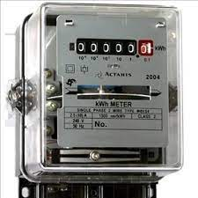
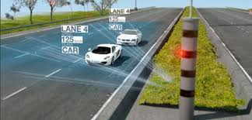
Anticipated calendar of events for the coming year in the RLMO
AFRIMETS TC Legal Meeting – 2021 Q4
  WG Prepackages
Workshop Electricity/ Speed Meters
  Will take place at the time of the AFRIMETS TC Legal Meeting

Slide 5
Comments on RLMO discussion topics for this year
Discussion Topic:
How is your RLMO approaching ‘digitalization’ pertaining to measuring instruments in your region?
Would be used as a catalyst for discussion within AFRIMETS TC Legal

Slide 6

Summary/Concluding remarks
AFRIMETS Co-Secretariat to work at getting technical work back to “normality”

