Slide 1
Update from the RLMO
by Peter Ulbig, COOMET Vice president for Legal Metrology
RLMO Round Table, online, October 6, 2020

Slide 2
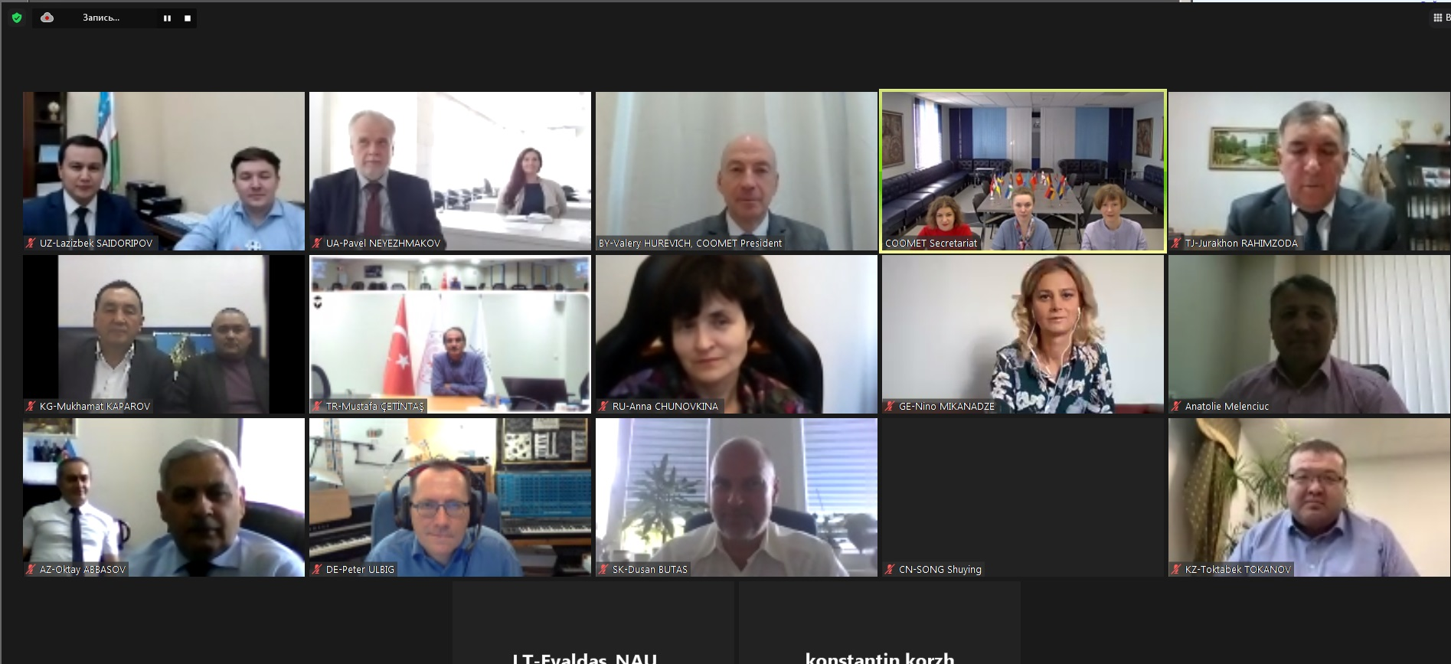
Overview about COOMET:
We adapted! (like everybody else)
No big changes regarding members etc.
COOMET strategy updated (goals, tasks, activities)
Legal status still open (analysis ongoing)
30th COOMET Committee Meeting, September 24, 2020 (using ZOOM client)

Slide 3
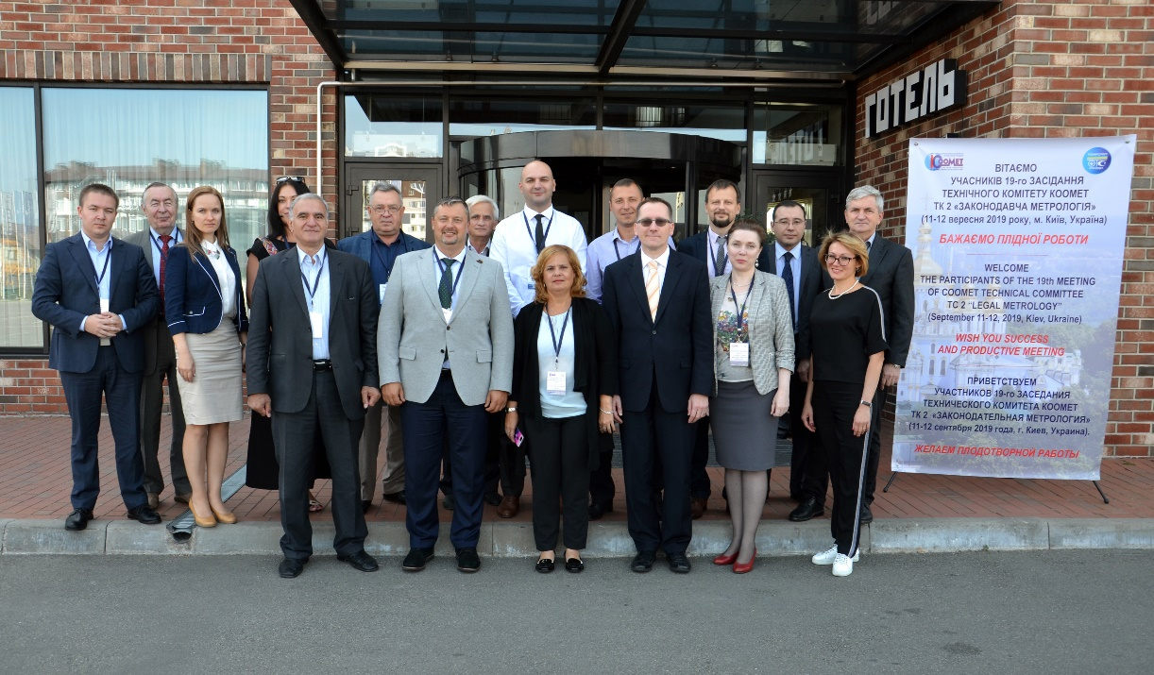
COOMET TC 2 “Legal Metrology”
Last „physical“ meeting
September 13, 2019
Next meeting online
October 29, 2019

Slide 4
RLMO discussion topics
1. Under the current circumstances (pandemic, travel, financial, etc.), have any of your RLMOs been able to conduct any business since last October (in-person and/or online)?
2. How is your RLMO coping with the pandemic situation? What short-term and long-term changes you foresee to your RLMO?
There is an impact: - meetings have moved to online meetings - some meetings and seminars have postponed to next year, but only a few - but main work has been done
- The first online meeting was very difficult, but it went better over time. - The biggest difficulty seem to be the realization of peer reviews only online. It‘s just not the same. - Changes: We didn‘t give up the hope to have physical meetings, but we need to be prepared for online-meetings for a long time.

Slide 5
3. How might the relationship between the OIML and the RLMOs be enhanced or augmented?
a. What do RLMOs do that the OIML does not or cannot do?
b. How can the OIML better help your region/economies? What are your most urgent regional/economies’ needs from the OIML (e.g., R 76 pilot, D 1, etc.)?
c. Does any duplication of activities exist within regional bodies, between regional bodies, and with the OIML?
d. In cases where RLMOs and RMOs are different organizations in the same region, how is coordination accomplished, both between themselves and with the BIML and the BIPM?
Exchange on legislation of regional groups of states.
Digitalisation should be „harmonized“ on international level.
No, not really.

Slide 6
4. How might the scope of the RLMO Round Table be expanded to enhance collaboration and sharing of ideas beyond just reporting by the RLMO representatives at the annual RT meetings?
How might the RLMO Round Table be restructured to better serve your needs?
Share training materials, including e-learning modules, among RLMOs?
b. Send representatives to each other’s RLMO meetings?
What do we have in common? We need to adapt to future challenges: Digitalization, renewable energies, diagnosis from the distance …
Of course, that‘s why we need the OIML e-learning platform.
In principle yes, because good ideas can be found everywhere. For example, WELMEC Guide 7.2 is translated to Russian language by COOMET.

Slide 7
c. Formalize the relationships between the RLMOs and OIML, including development of Terms of Reference (ToR) for the RLMO Round Table?
Should the OIML formalize what it considers to be an RLMO (e.g., what kind of grouping is/represents an RLMO)?
e. Should there be membership/participation criteria for the RLMO Round Table?
Maybe not, one should not overregulate a system.
RLMOs are not founded frequently, but there should be some kind of minimum number of countries to be called a region.
Especially in today´s situation where we are used to video conferencing,
There is always the option to have „official representatives“ and „observers“.
Therefore the number of people should not be limited.

Slide 8
5. Should the individual RLMO reporting format at future RLMO Round Table meetings be standardized in order to focus discussion on certain topics? Topics could include:
Is your RLMO a legal entity? If not, are there plans to move in that direction?
Do you feel that there is ‘dumping’ of measuring instruments (that is, intentional sale of measuring instruments that do not meet verification requirements) going on in your region? If so, in what area(s)?
c. How do the economies in your region participate in the OIML-CS?
d. Are there any impediments to participation?
e. Do the economies in your region accept OIML Certificates/Test data?
It should be a mixture of - topics the RLMOs can address by themselve, and - topics, which are agreed by all representatives for the coming year, and
- the chair should be allowed to propose topics.

Slide 9
6. Does your RLMO have any suggestions on how the OIML Bulletin might become more valuable to your RLMO, and to the OIML, in the future?
What useful articles can your RLMO provide for the Bulletin?
b. Should the RLMO reports presented at the RLMO Round Table meeting be made available in a separate RLMO Round Table section of the OIML web site, and/or in the OIML Bulletin?
- Reports of the annual meetings - Reports on seminars/workshops for the region or for single countries - Reports on analyzes that have been prepared by the RLMO for the region - Important changes in the legislation of single countries or concerning regional legislation (e. g. EEC, EU, etc.)
- There could be a report on the RLMO RT meeting in the Bulletin, where the most important information from each RLMO can be found.

Slide 10
We intend to discuss all those questions
in more detail on October 29, 2020
at the next COOMET TC 2 meeting.
10

