Slide 1
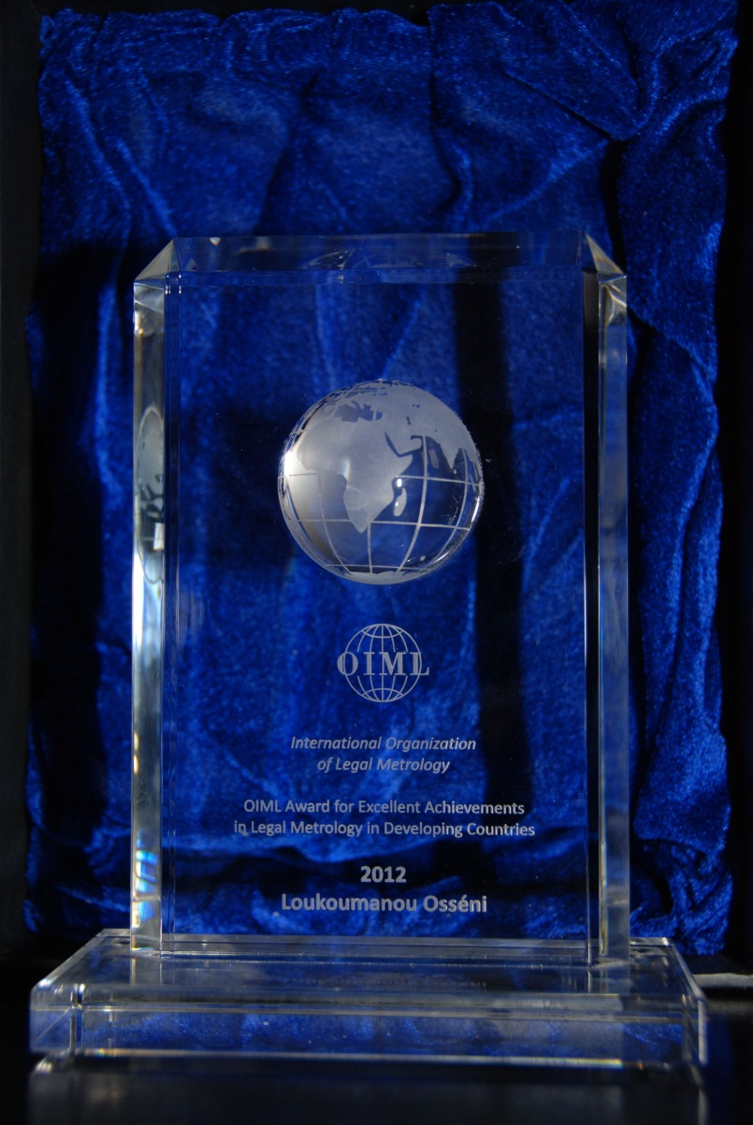
Agenda item 13
OIML Award for excellent contributions in
legal metrology in developing countries

Slide 2
2012 Award
Three nominees for this 4th Award:
Mr. Loukoumanou Osséni, Bénin
Directorate of Metrology, Indonesia
Mrs Galitsyna Lyubov, Kazakhstan

Slide 3
Award goes to:
Mr. Loukoumanou Osséni, Bénin
Letters of appreciation go to:
Directorate of Metrology, Indonesia
Mrs Galitsyna Lyubov, Kazakhstan

Slide 4
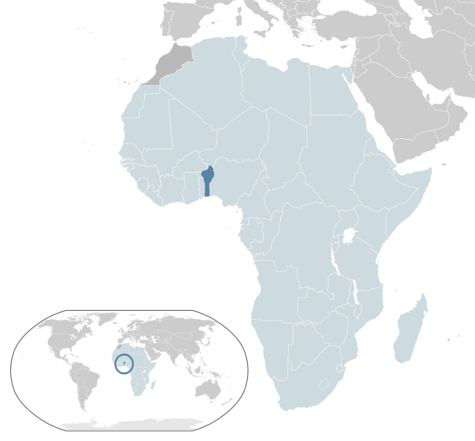
Bénin
Population 9.6 million
GDP/capita 1 500 USD
∴ ranked 200/226 in world
Is a UN Least Developed Country (LDC)

Slide 5
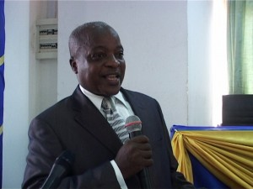
Mr. Loukoumanou Osséni

Slide 6
Achievements:
Doctor of Economics, practical training in legal metrology
General Director of the “Agence Béninoise de la Métrologie et de Gestion de la Qualité (ABMCQ)” since April 2002
development of 3-year engineers’ training schedule at “Ecole des Mines” in Douai, France
conception and realisation of five sketches for awareness-raising on metrology
  “The importance of a metrology structure”,
  “Metrology in commerce”,
  “Metrology in health”,
  “Metrology and the environment”
  “Metrology in the commercialisation of electric energy”

Slide 7
Achievements continued:
documentary on the activities of metrology
several interactive television programs on metrology
website on the structure of metrology in Benin
“quinzaine de la métrologie” (“Metrology fortnight”)
  two week event dedicated to awareness-raising among stakeholders in the field of metrology as well as among political decision makers
institute ISO 17025 accredited for mass in class F₁, from 1 mg to 20 kg
  only public calibration institute in the French-speaking ECOWAS member countries
training technicians from Mali, Côte d'Ivoire, Guinée Bissau, Niger, Burundi
government of Benin sent Mr. Osséni to Haiti in 2005 as a legal metrology consultant

