Slide 1
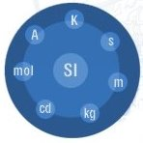
New SI
Possible consequences for “practical metrology”
Philippe Richard
46th CIML, Prague

Slide 2
AdHoc OIML working on the new SI
The Presidential Council nominated at its March 2011 meeting the following members:
Ch. Ehrlich (NIST)
Y. Miki (NMIJ)
Ph. Richard (METAS)
R. Schwartz (PTB)
Invited to join:
M. Kühne (Director BIPM)
A. Leitner (BEV, OIML delegate at the CCU)

Slide 3
Terms of reference
The AdHoc OIML working group on the new SI is responsible to:
Inform the OIML (CIML) about the current discussions and proposals concerning the "New SI"
Initiate an official statement of the OIML (CIML) in response to the Draft Resolution A of the CIPM/CGPM.

Slide 4
First preliminary meeting
Took place at METAS on May 31st 2011 to
Establish the contact with the BIPM
Initiate the work
Collect available information and litterature
Decide how to inform the CIML on
  The possible future revision of the SI
  How to evaluate the possible consequences for “practical metrology” (legal metrology)
The BIPM welcomes an official statement from the OIML on the possible revision of the SI

Slide 5
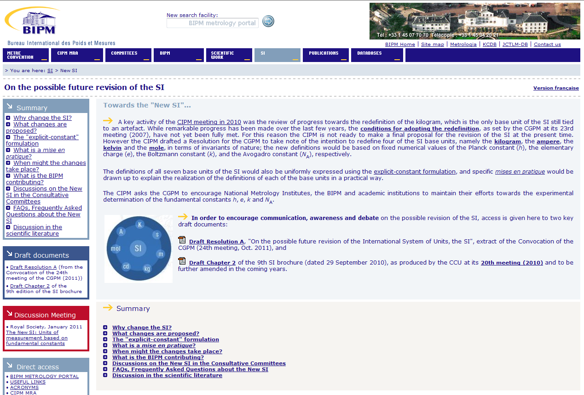
BIPM web site on the new SI
http://www.bipm.org/en/si/new_si/

Slide 6

Where to find general information?
The BIPM web site contains a lot of usefull information, publications, FAQ.
Most relevant information:
General BIPM web site: http://www.bipm.org/en/si/new_si/
CGPM draft resolution A: http://www.bipm.org/utils/common/pdf/24_CGPM_Convocation_Draft_Resolution_A.pdf
Draft Chapter 2 of the future SI brochure: http://www.bipm.org/utils/common/pdf/si_brochure_draft_ch2.pdf
A special article by Richard Davis on the «Proposed change to the definition of the kilogram: consequences for legal metrology» will be published soon in the OIML Bulletin.

Slide 7
Analysis of possible consequences
How to best evaluate the possible consequences for practical / legal metrology?
Mention OIML explicitely in the CGPM resolution A next week
All CIML member invite those parties in their country that represent legal / practical metrology, in order to receive a broad feedback on the ideas of a "New SI“
The CIML invites the TCs/SCs to send their comments about the possible consequences in their domains to the AdHoc working group «New SI»
(Concerns in priority TC 2, TC 9, TC 9 SC 3 and TC 11)
Resolution of the 46th CIML meeting

Slide 8
Time schedule
28.02.2012 Comments from individual CIML members and from the TC SCs to the working group.
March 2012 First review of the answers by the Presidential Council
April 2012 Detailed review by the members of the working group
June 2012 Submission of the OIML statement for the 14th OIML Conference
July 2012 Preparation of a second article for the OIML Bulletin with the OIML official position
October 2012 Information of the CCU about the OIML statement.

Slide 9
Draft Resolution 1/2
The Committee,
Expresses its appreciation to Messrs. Arnold Leitner and Philippe Richard for their presentation about the proposed changes to the SI (International System of Units), currently discussed by the BIPM and the impact of those changes on legal metrology,
Encourages all its Members and relevant Technical Committees, in particular TC 2, TC 9, TC 9/SC 3 and TC 11, to actively participate in the discussion and provide comments to the ad-hoc OIML Working Group “New SI” before 24 February 2012,

Slide 10
Draft Resolution 2/2
The Committee,
Thanks Mr. Arnold Leitner for representing the OIML in the CCU (Consultative Committee of Units of the BIPM) over many years, and,
Welcomes the nomination by TC 12 of Mr. Philippe Richard as the new OIML representative in the CCU.

Slide 11



Conclusion
There must not necessarily be a single official statement by the OIML; it would also be useful for the CCU / CIPM if the OIML statement contained different opinions from different fields of metrology.
Thanks in advance for YOUR contribution to the new SI !

